Slide 1


From C++ to COM
COM Programming
Notes:
Page <number>
WNCOMPG-2 v1.5
Chapter 2, From C++ to COM

Slide 2


Chapter Overview
Objective
  Develop a simple model for implementing reusable components in C++
Chapter content
  Component based development
  Problems with traditional C++ class libraries
  Separating a component's interface from its implementation
  Using an abstract base class
  Use of virtual function tables
  Run-time discovery of a component's interfaces
  Eliminating compiler dependencies
  Managing the lifetime of a component
  Reference counting
Practical content
  Develop and test a simple reusable component using C++
Summary
Notes:
Page <number>
WNCOMPG-2 v1.5
Chapter 2, From C++ to COM

Slide 3
Component Based Development
The motives...
We want to build dynamically composable systems
  Not monolithic statically linked applications
We want to minimise coupling within the system
  One change propagates to entire source code tree
We want plug-and-play replaceability and extensibility
  New pieces should be indistinguishable from old, known parts
We want implementation language neutrality
We want freedom from file/path dependencies
We want components with different runtime requirements to live peaceably together
  Need to mix heterogeneous objects in a single process
  Language independence
Notes:
Page <number>
WNCOMPG-2 v1.5
Chapter 2, From C++ to COM

Slide 4


Component Deployment
Components can provide both location and implementation transparency
  Can be located in the same process as the component user, in different processes on the same host, or on different hosts
client : Win32 PC
*
server : NT Server
1
TCP/IP
client.exe
server.exe
business.dll
dbc.dll
Notes:
Page <number>
WNCOMPG-2 v1.5
Chapter 2, From C++ to COM

Slide 5


So how about C++?
C++ is a language and not a binary standard
  Name mangling, exception handling
  All components must be developed with same compiler
Poor support for other languages
  Exposing 'C' functions!
Produces closely coupled systems
  class used for both definition and implementation
  Changing private data items forces a rebuild
No location transparency / file path independence
  No implicit runtime support
Consequently, we need to think imaginatively to do components (and we need runtime support!)
Notes:
Page <number>
WNCOMPG-2 v1.5
Chapter 2, From C++ to COM

Slide 6
COM to the Rescue!
So what is COM?
"A programming discipline, combined with a supporting runtime infrastructure, which together facilitate the development of component-based software systems"
In other words:
Microsoft’s component based technology
Don’t be confused by terms such as OLE or ActiveX
  These are COM-based technologies directed at particular problem domains
  It’s all just COM!
Notes:
Page <number>
WNCOMPG-2 v1.5
Chapter 2, From C++ to COM

Slide 7

And COM+ ?
Extends the basic component object interaction model
  Builds on MTS
  Declarative use of services where possible
  True object pooling
  Activators and interceptors
Defines new services for COM components
New COM+ Services
➔ Dynamic load balancing
➔ Events (publish/subscribe)
➔ Queued components (Asynchronous
method calls using MSMQ)
➔ Improved security
➔ Extended transaction support
Notes:
Page <number>
WNCOMPG-2 v1.5
Chapter 2, From C++ to COM

Slide 8
Migrating from C++ to COM
How do we migrate the following class?
// Account.h
class Account {
float m_balance;
public:
Account();
~Account();
void Deposit(float amount);
void Withdraw(float amount);
float GetBalance() {return m_balance;}
};
Notes:
Page <number>
WNCOMPG-2 v1.5
Chapter 2, From C++ to COM

Slide 9
Interface Based Programming
Separating implementation from definition of behaviour
What is an interface?
  A collection of logically related functions
  Immutable after it has been defined
The most recognisable interface on the planet?
Notes:
Page <number>
WNCOMPG-2 v1.5
Chapter 2, From C++ to COM

Slide 10
Decoupling the Interface
Need two classes ...
  One to represent interface
  Other to represent implementation
… plus some association between the two
Two ways to achieve this:
A. Use handle class for interface
B. Use abstract base class for interface
IAccount
<<interface>>
IAccount
Deposit
Withdraw
GetBalance
Deposit
Withdraw
GetBalance
delegates
inherits
CAccount
CAccount
Deposit
Withdraw
GetBalance
Deposit
Withdraw
GetBalance
Notes:
Page <number>
WNCOMPG-2 v1.5
Chapter 2, From C++ to COM

Slide 11
Using an Abstract Base Class
Define interface in abstract base class
Implement interface in a derived class
IAccount interface
// IAccount.h
struct IAccount
{
virtual void Deposit(float amount) = 0;
virtual void Withdraw(float amount) = 0;
virtual float GetBalance() = 0;
};
CAccount implementation
// CAccount.h
class CAccount : public IAccount {
float m_balance;
public:
Account();
~Account();
void Deposit(float amount);
void Withdraw(float amount);
float GetBalance() {return m_balance;}
};
Notes:
Page <number>
WNCOMPG-2 v1.5
Chapter 2, From C++ to COM

Slide 12
"Vtable" Mechanism
Virtual-function table implemented by C++ compilers
Key to binary compatibility
Provides level of indirection
Fixes name-mangling problem
Client
IAccount interface
CAccount
implementation
pIAccount
Virtual function table
Deposit
Withdraw
GetBalance
vtbl pointer
Deposit
Withdraw
GetBalance
Notes:
Page <number>
WNCOMPG-2 v1.5
Chapter 2, From C++ to COM

Slide 13
Client Code
Problem is that client uses new operator
    Only supports C++ clients
    Client developer needs implementation-class definition
    Gives client access to complete object, not just to its interface
// Client.cpp
#include "CAccount.h" // implementation header!
int main() {
CAccount *pCAccount = new CAccount(100.00);
// get an IAccount pointer
IAccount *pIAccount = pCAccount;
// perform some operations on the Account object
pIAccount->Deposit(50.00);
float balance = pIAccount->GetBalance();
cout << "Final balance is " << balance << endl;
...
Notes:
Page <number>
WNCOMPG-2 v1.5
Chapter 2, From C++ to COM

Slide 14
Restricting Client Access
Provide global CreateXXX() wrapper function
  Calls new on client's behalf
  Returns a pointer to object's interface, not its implementation
IAccount interface
// IAccount.h
class IAccount {
public:
virtual void Deposit(float amount) = 0;
...
};
extern "C" IAccount *CreateAccount();
Allows linking
to "C" clients
CAccount implementation
// CAccount.cpp
...
IAccount *CreateAccount() {
return new CAccount;
}
Notes:
Page <number>
WNCOMPG-2 v1.5
Chapter 2, From C++ to COM

Slide 15
Object Destruction
Must also provide matching Delete() function
  Another virtual function in each interface
  Calls delete on client's behalf
IAccount interface
// IAccount.h
class IAccount {
public:
virtual void Deposit(float amount) = 0;
...
virtual void Delete() = 0;
};
extern "C" IAccount *CreateAccount();
CAccount implementation
// CAccount.cpp
...
void CAccount::Delete() {
delete this;
}
Notes:
Page <number>
WNCOMPG-2 v1.5
Chapter 2, From C++ to COM

Slide 16
Revised Client Code
  Client can only access object through its interface
  Client developer doesn't need definition of implementation class
  Client could be written in another language
// Client.cpp
#include "IAccount.h" // interface header only
int main() {
// get an IAccount pointer
IAccount *pIAccount = CreateAccount(100.00);
if (pIAccount) {
// perform some operations on the Account object
pIAccount->Deposit(50.00);
float balance = pIAccount->GetBalance();
...
pIAccount->Delete(); // finished with IAccount
}
...
Notes:
Page <number>
WNCOMPG-2 v1.5
Chapter 2, From C++ to COM

Slide 17
Extending an Interface
An interface is immutable
  A binary and semantic contract
  Once published, cannot change signatures or semantics
But, a new interface can inherit from another interface
  Only single inheritance allowed
Virtual function table
<<interface>>
IAccount
pIAccount
vtbl pointer
Deposit
Deposit
Withdraw
GetBalance
Withdraw
GetBalance
<<interface>>
ISavingsAccount
pISavingsAccount
vtbl pointer
Deposit
CalculateInterest
GetInterestRate
Withdraw
GetBalance
CalculateInterest
GetInterestRate
Notes:
Page <number>
WNCOMPG-2 v1.5
Chapter 2, From C++ to COM

Slide 18
Extending a Component
Implementation can expose more than one interface
  Can use multiple inheritance
  Must implement all the functions of each interface
<<interface>>
IAccount
<<interface>>
ITrade
Deposit
Withdraw
GetBalance
Buy
Sell
GetPrice
Note: The Delete() function has been
omitted for clarity.
Virtual function table
pIAccount
vtbl pointer
Deposit
CTradingAccount
pITrade
vtbl pointer
Withdraw
Deposit
Withdraw
GetBalance
Buy
Sell
GetPrice
GetBalance
Buy
Sell
GetPrice
Notes:
Page <number>
WNCOMPG-2 v1.5
Chapter 2, From C++ to COM

Slide 19
Discovering a Component's Interfaces
Client could use RTTI (dynamic_cast<> operator)
Problem is that RTTI is compiler dependent
  Client and component developers must use same C++ compiler!
  What about non-C++ clients?
// Client.cpp ----------------------------
...
// get an IAccount pointer
IAccount *pIAccount = CreateAccount(100.00);
if (pIAccount) {
// now try and get an ITrade pointer
ITrade *pITrade = dynamic_cast<ITrade*>(pIAccount);
if (pITrade) {
pITrade->GetPrice();
...
}
pIAccount->Delete();
}
...
Notes:
Page <number>
WNCOMPG-2 v1.5
Chapter 2, From C++ to COM

Slide 20
Eliminating Compiler Dependencies
Provide a well-known DynamicCast() function
  Another virtual function in each interface
  Same semantics as dynamic_cast<> operator
Could factor out common functions to a base interface
All derived interfaces will have these functions as the first two entries in their vtables
IBase interface
class IBase {
public:
virtual void *DynamicCast(const char *pszType) = 0;
virtual void Delete() = 0;
};
pIAccount
vtbl pointer
DynamicCast
Delete
Deposit
Withdraw
GetBalance
Notes:
Page <number>
WNCOMPG-2 v1.5
Chapter 2, From C++ to COM

Slide 21
Revised Implementation Code
class IAccount : public IBase {
public:
virtual void Deposit(float amount) = 0;
virtual void Withdraw(float amount) = 0;
};
IAccount interface
class ITrade : public IBase {
public:
virtual void Buy(long quantity) = 0;
virtual void Sell(long quantity) = 0;
};
ITrade interface
class CTradingAccount : public IAccount, public ITrade {
public:
...
// IAccount functions
void Deposit(float amount);
...
// ITrade functions
void Buy(long quantity);
void Sell(long quantity);
...
// IBase functions
void *DynamicCast(const char *pszType);
void Delete() {delete this; }
};
CTradingAccount implementation:
Must implement all the functions of the IAccount, ITrade and the IBase interfaces
Notes:
Page <number>
WNCOMPG-2 v1.5
Chapter 2, From C++ to COM

Slide 22
Implementation of DynamicCast()
Allows client to request pointer to specified interface
Use static_cast<> operator to simulate RTTI
// CTradingAccount.cpp
...
void *CTradingAccount::DynamicCast(const char *pszType) {
if (strcmp(pszType, "IAccount") == 0)
return static_cast<IAccount*>(this);
else if (strcmp(pszType, "ITrade") == 0)
return static_cast<ITrade*>(this);
else if (strcmp(pszType, "IBase") == 0)
return static_cast<IAccount*>(this);
else
return 0; // unsupported interface
}
Note: static_cast<IBase*>(this) would be ambiguous!
Notes:
Page <number>
WNCOMPG-2 v1.5
Chapter 2, From C++ to COM

Slide 23
Instance Management
Replace CreateXXX() by a CreateObject() function that returns a pointer to component's IBase interface
Client is responsible for managing component's lifetime
  Call CreateXXX() to get pointer to component's IBase
  Call DynamicCast() to get pointer to a specified interface
  Call Delete() (through any pointer) to destroy object
  Must track which pointer refers to which interface and only call Delete() once per object!
Component should really manage its own life time
  Implement reference counting
  Commit suicide when reference count falls to zero
CTradingAccount implementation
IBase *CreateObject() {
return reinterpret_cast<IBase *>(new CTradingAccount);
}
Notes:
Page <number>
WNCOMPG-2 v1.5
Chapter 2, From C++ to COM

Slide 24
Reference Counting (1)
In IBase, replace Delete() by IncrementRef() and DecrementRef() functions
DynamicCast() should auto-increment count
To avoid memory leaks, client must follow the rules:
  Call IncrementRef() after duplicating an interface pointer
  Call DecrementRef() when an interface pointer is no longer required
IBase interface
class IBase {
public:
virtual void *DynamicCast(const char *pszType) = 0;
virtual void IncrementRef() = 0;
virtual void DecrementRef() = 0;
};
Notes:
Page <number>
WNCOMPG-2 v1.5
Chapter 2, From C++ to COM

Slide 25
Reference Counting (2)
Implementation is almost trivial
CreateObject() should auto-increment count
CAccount implementation
// CTradingAccount.h
class CTradingAccount : public IAccount, public ITrade {
long m_cRef;
...
public:
CAccount() : m_cRef(0) {} // count = 0
void IncrementRef() {
++m_cRef;
}
void DecrementRef() {
if (--m_cRef == 0)
delete this; // self destruct
}
...
};
Notes:
Page <number>
WNCOMPG-2 v1.5
Chapter 2, From C++ to COM

Slide 26
Revised Client Code
int main() {
IBase *pIBase = CreateObject(); // ref count auto-incremented
if (pIBase)
{
// try and get an IAccount pointer
IAccount *pIAccount = (IAccount *)pIBase->DynamicCast("IAccount");
if (pIAccount) { // ref count auto-incremented
// perform some operations on the Account object
pIAccount->Deposit(10000.00);
// now try and get an ITrade pointer
ITrade *pITrade = (ITrade *) pIBase->DynamicCast("ITrade");
if (pITrade) { // ref count auto-incremented
float price = pITrade->GetPrice();
pITrade->DecrementRef(); // finished with ITrade
}
balance = pIAccount->GetBalance();
pIAccount->DecrementRef(); // finished with IAccount
}
pIBase->DecrementRef(); // finished with IBase
}
...
Notes:
Page <number>
WNCOMPG-2 v1.5
Chapter 2, From C++ to COM

Slide 27
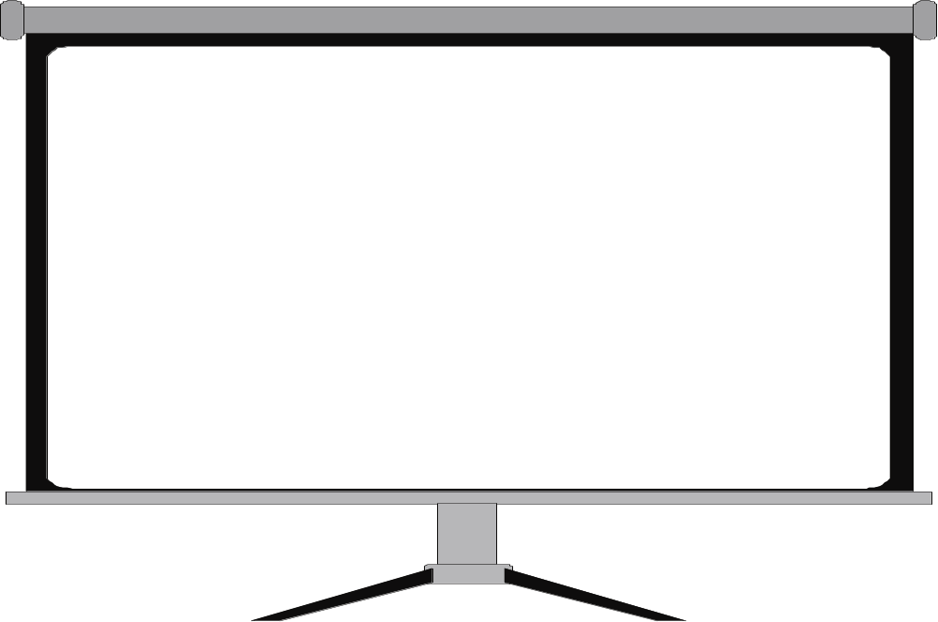
What Have We Achieved?
Objective: Develop a simple model for reusable components
Separate interface and implementation
Full binary encapsulation
Functionality can be extended
C++ compiler independent
Supports non-C++ clients
Run-time discovery of interfaces
Component manages its own lifetime
This is the basis of Microsoft COM
Notes:
Page <number>
WNCOMPG-2 v1.5
Chapter 2, From C++ to COM

Slide 28
Summary
Difficult to rewrite reusable class libraries in C++
  Lack of binary encapsulation, binary standard, name mangling, etc.
Need to separate a component's interface from its implementation
  Can be achieved by defining interface in a "pure" abstract base class
  Creation and deletion need to handled by wrapper functions
Once defined, an interface is immutable, but
  One interface can inherit from one other interface
  A component can implement multiple interfaces
Component interface(s) can be discovered at run time
  Base interface must provide a DynamicCast() function
A component can manage its own lifetime
  Base interface must also provide IncrementRef() and DecrementRef() functions
  Client must follow the rules to avoid memory leaks
Notes:
Page <number>
WNCOMPG-2 v1.5
Chapter 2, From C++ to COM

